Slide 1

Advance Prediction of Boiling Crisis Through Acoustic Signal Analysis
Presented by:
Ayush Gupta (1901ME13)
Kritadhi Maity (1901ME36)
Mentored By:
Dr. Atul Thakur
Dr. Rishi Raj

Slide 2
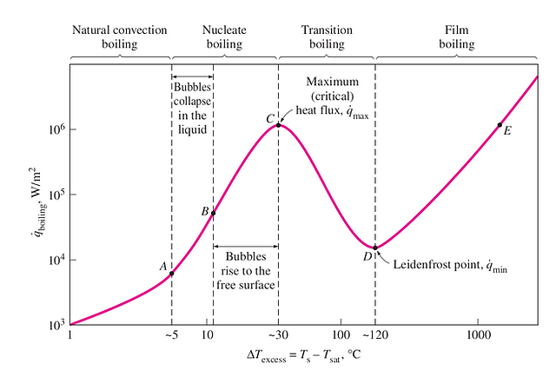
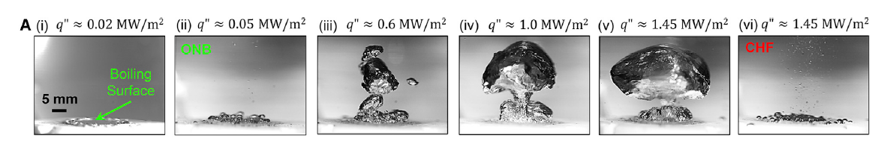
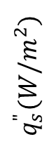
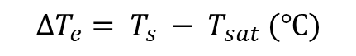
Background & Motivation
Hence our problem translates to an accurate knowledge of the boiling regime near the Critical Heat Flux for advance prediction of the boiling crisis.
$$q_{s}^{"}{(W/m}^{2})$$
$$∆T_{e}= T_{s} − T_{sat} (℃)$$
Source : https://www.mechnflow.com/post/pool-boiling
A. ONB
B. Bubble Collapse
C. Critical Heat Flux
Image Source : https://www.sciencedirect.com/science/article/pii/S2666386421000722?via%3Dihub

Slide 3
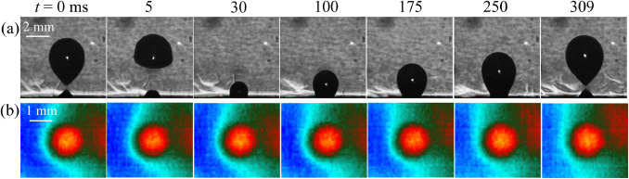
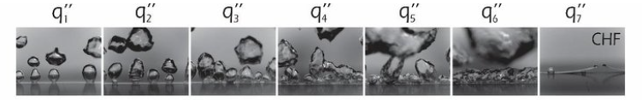
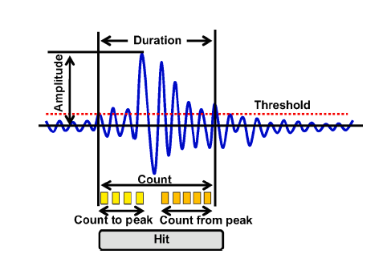

Literature Review : Various Approaches tried for finding precursors to CHF
Thermal Mapping:
Image processing of nucleate boiling
Image Source : https://www.sciencedirect.com/science/article/pii/S2666386421000722?via%3Dihub
Image Source : https://doi.org/10.1016/j.ijheatmasstransfer.2020.119775
Acoustic Emission Analysis : Sound of Boiling
Image Source : https://www.123rf.com/photo_10504252_water-bubbles-blose-up-on-white-background.html
Image Source : https://doi.org/10.1016/j.eswa.2020.114391

Slide 4
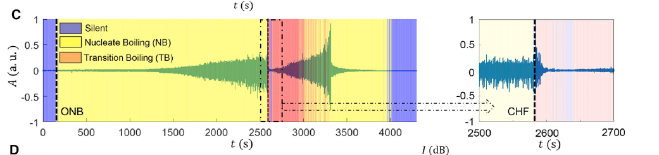
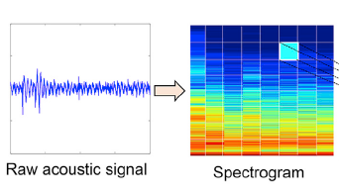
Literature Review (Contd.)
A (a.u.)
Image Source: https://doi.org/10.1016/j.xcrp.2021.100382
In Sinha et al. the spectrogram of bubble acoustics serves as the fingerprint of boiling regimes.
Image Source: https://doi.org/10.1016/j.xcrp.2021.100382
Deep Learning To Feature Selection
In the study different boiling regimes could be easily differentiated.
But not able to predict when CHF would occur.
We turned to the work of Motahari et al, who utilized 60 features for sound analysis.
By leveraging these features, we hoped to transition from Deep Learning to supervised feature-based machine learning.

Slide 5
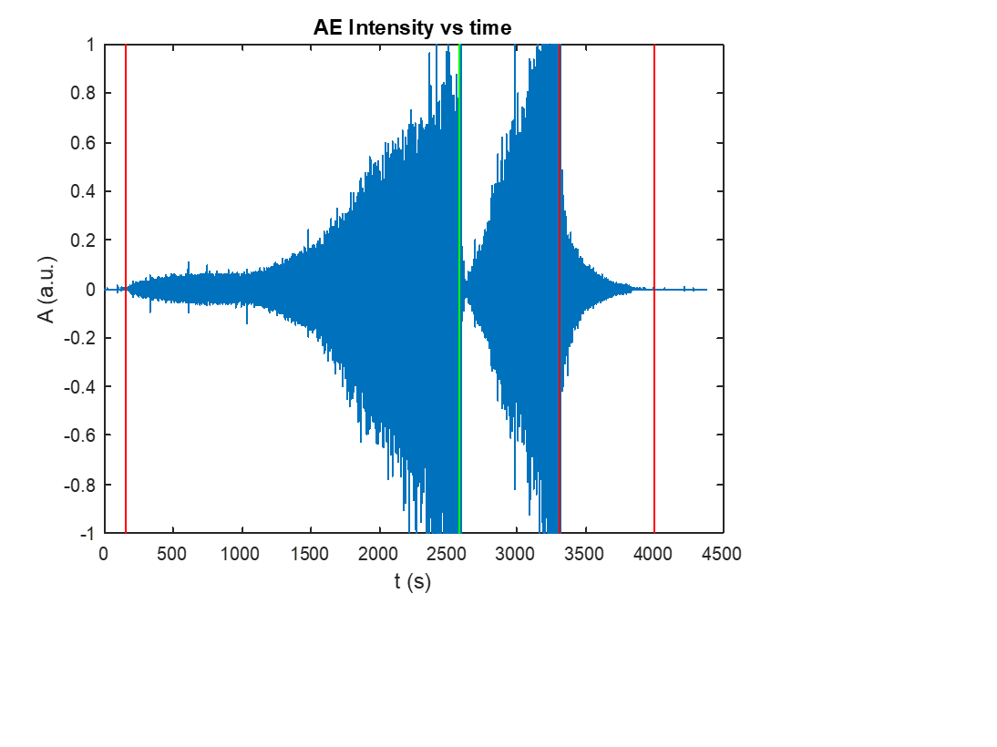
Audio Data Time Series Signal:
Figure Demarcations:
0 to 150s : Natural Convection as indicated by the red line
150 to 2581s : Nucleate boiling between red and green line
2582 to 3304s : Transition boiling between green and red line
3305 to 4000s : Fully fledged nucleate boiling between two red lines
4000 to 4500s : Natural convection
Acoustic Emission Signal Processing in Time Domain For Pre-Decided Features:
------ Energy ---> .
-------Time----->
Normal frame with 0% overlap and no varying frame size
50% frame overlap with no varying frame size
Varying Overlapping frames

Slide 6
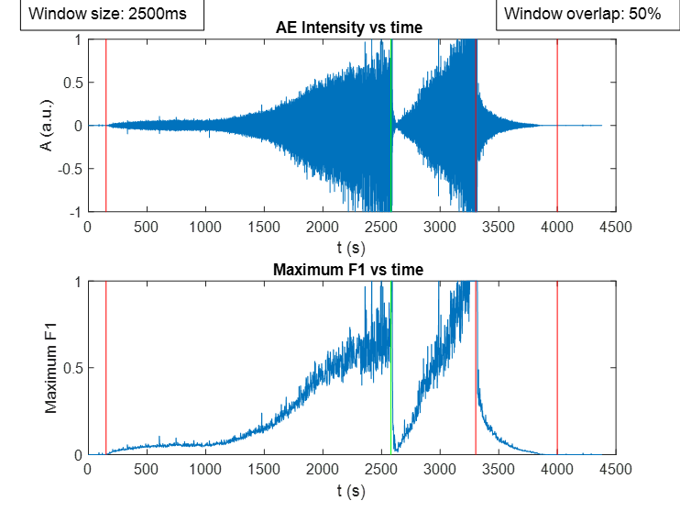
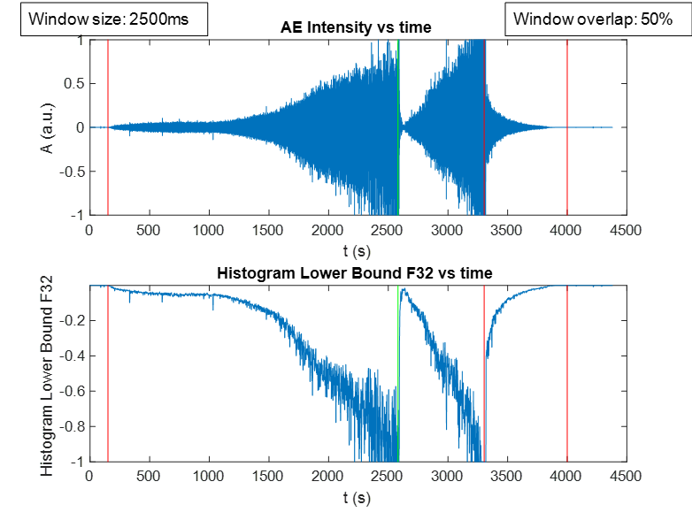
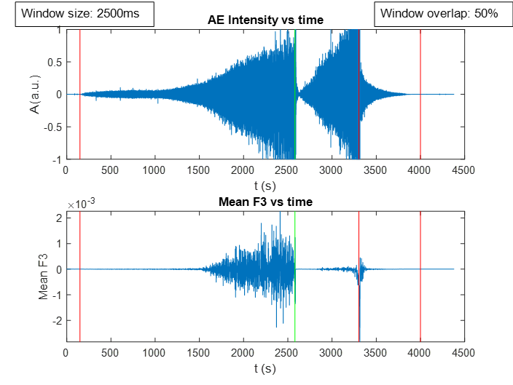
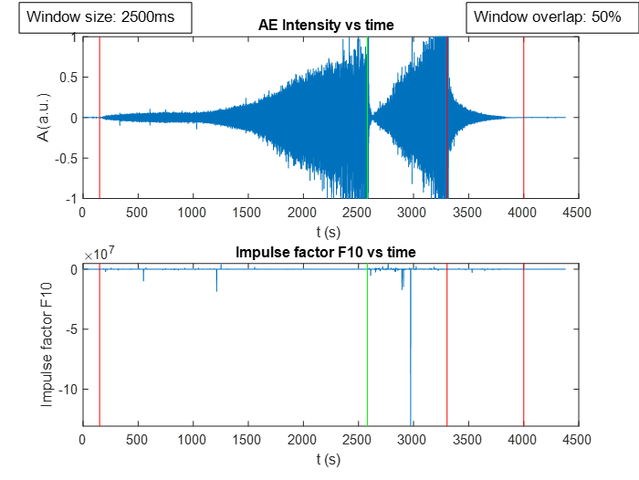
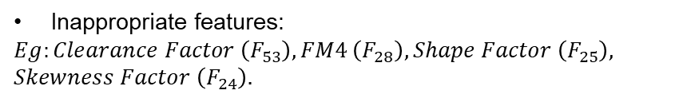
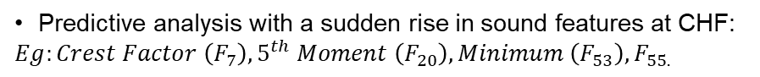
Categorisation :
Predictive analysis with a sudden drop in sound features at CHF:
$Eg:$ $Peak{ (F}_{5}), Energy{ (F}_{14}), RMS \left(F_{6}\right), Standard Deviation \left(F_{9}\right).$
Predictive analysis with a sudden rise in sound features at CHF:
$$Eg:Crest Factor \left(F_{7}\right), 5^{th} Moment \left(F_{20}\right), Minimum \left(F_{53}\right), F_{55.}$$
Predictive analysis with miscellaneous change in sound features at CHF:
$$Eg:Skewness \left(F_{23}\right), Most Frequent values in array \left(F_{54}\right), Median Value\left(F_{59}\right).$$
Inappropriate features:
$$Eg:Clearance Factor \left(F_{53}\right), FM4 \left(F_{28}\right), Shape Factor \left(F_{25}\right),$$
$$Skewness Factor \left(F_{24}\right).$$

Slide 7
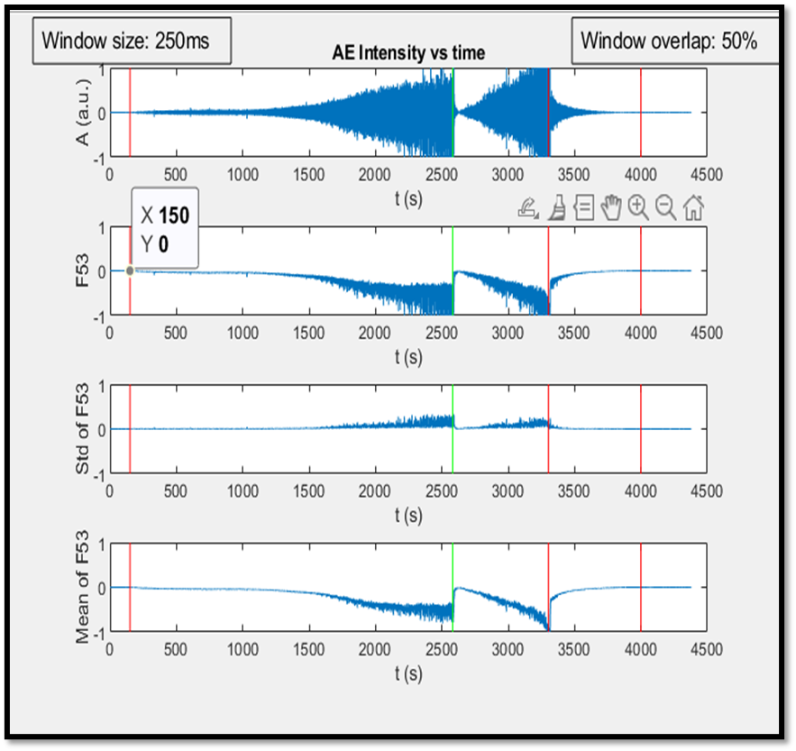
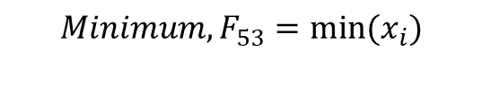
Feature Identification for Determination of Precursor to CHF:
Impact of Window-size, overlap and noise reduction
$$Minimum, F_{53}=min⁡(x_{i})$$

Slide 8
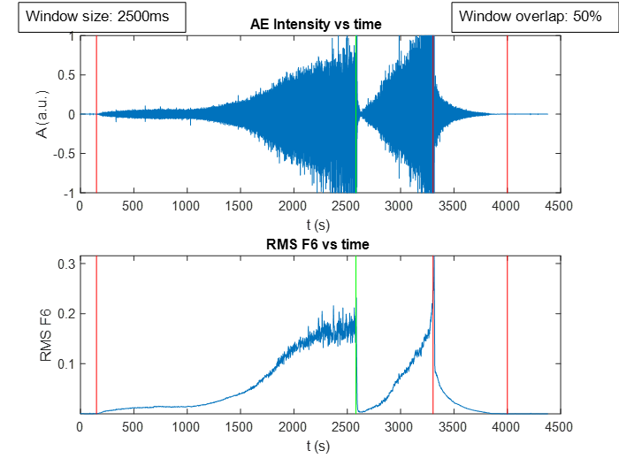
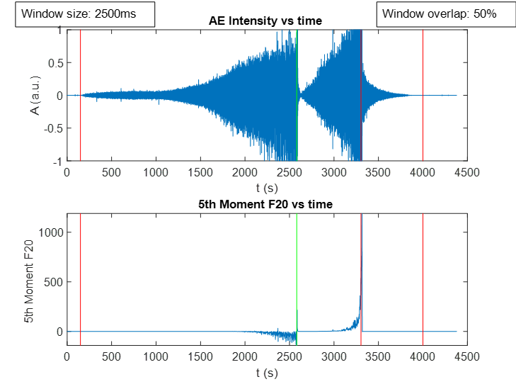
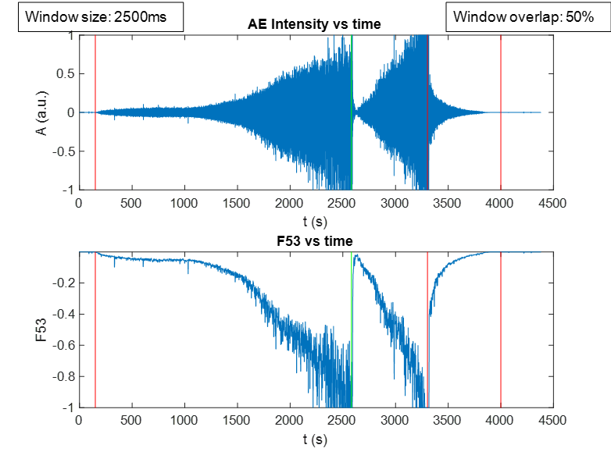
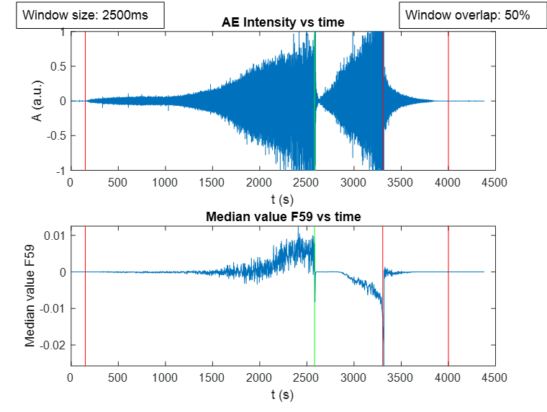
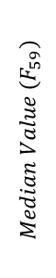
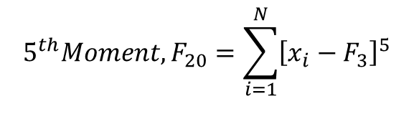
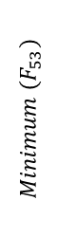
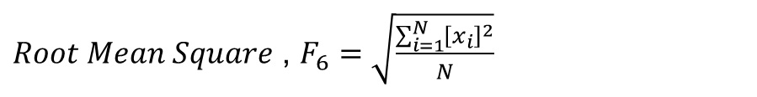
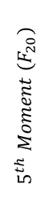
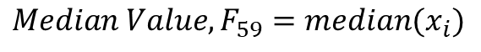
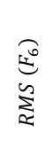
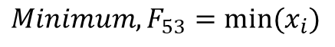

Dynamic Plotting of Acoustic Signal Features , Mean and Standard Deviation Against Audio Data Time Series:
$$RMS (F_{6})$$
$$5^{th} Moment (F_{20})$$
$Root Mean Square$ , $F_{6}=\sqrt{\frac{\sum_{i=1}^{N}{{\left[x_{i}\right]}^{2}}}{N}}$
$$5^{th}Moment, F_{20}=\sum_{i=1}^{N}{{\left[x_{i}−F_{3}\right]}^{5}}$$
$$Minimum (F_{53})$$
$$Minimum, F_{53}=min⁡(x_{i})$$
$$Median Value, F_{59}=median(x_{i})$$
$$Median Value (F_{59})$$
$$t(s)$$

Slide 9
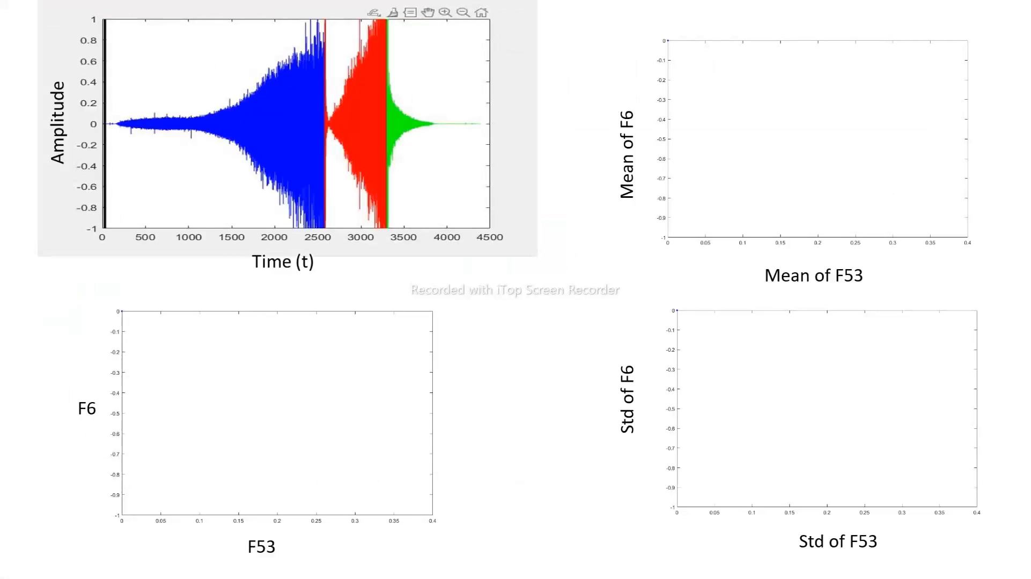

Slide 10
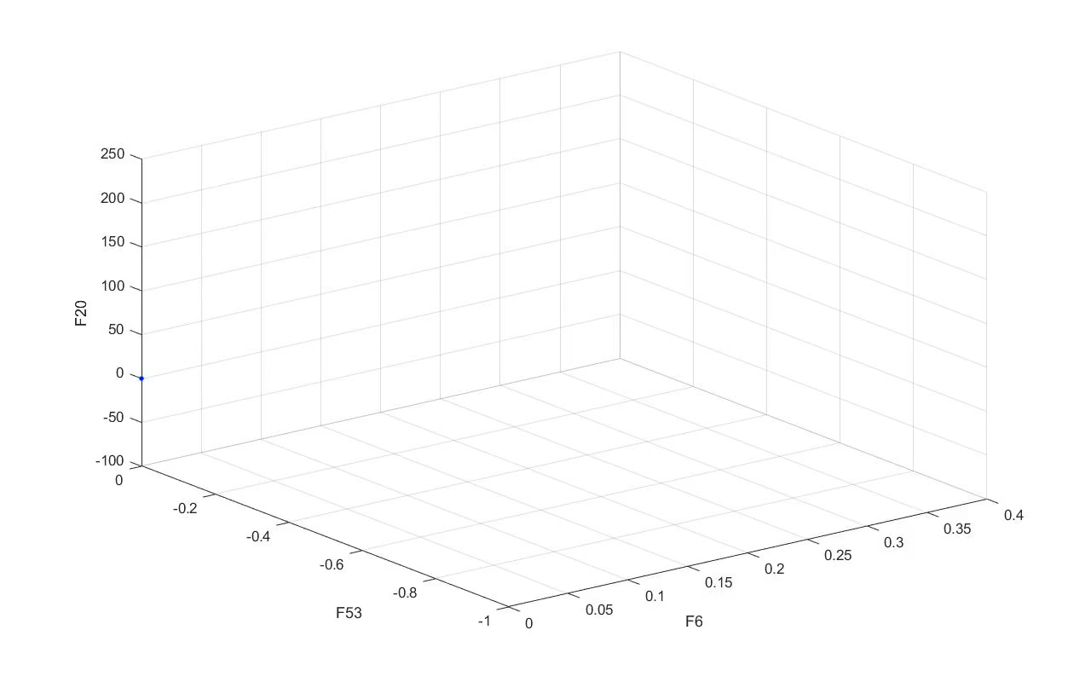
3D Visualisation :

Slide 11
Three-Dimensional Delta Distance(∆) vs Time Plotting of Features
a)
b)
c)
d)

Slide 12
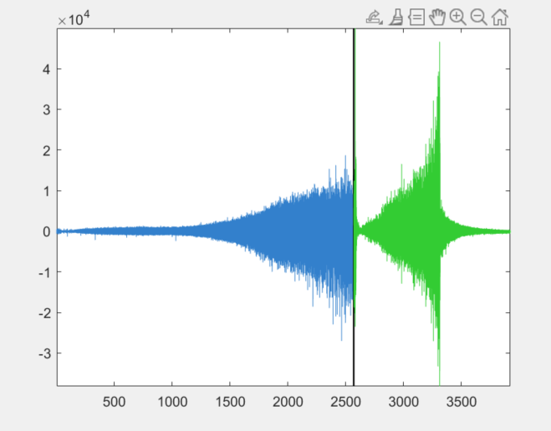
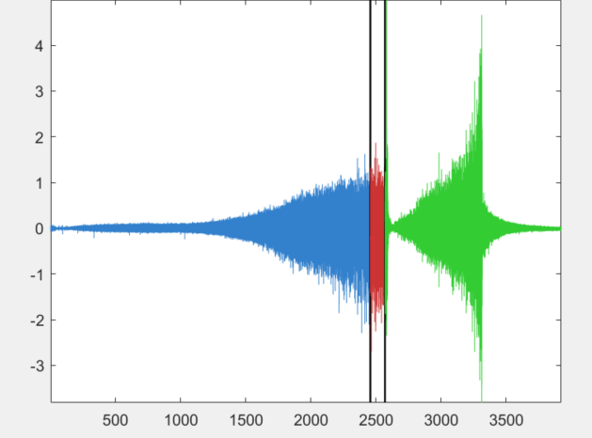
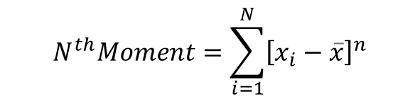

Criteria for CHF Prediction :
In order to quantify the sudden increase in the moment function we have used thresholds.
CHF
Moment Vs Time
$$4^{th} Moment$$
4
3
2
1
0
-1
-2
-3
Red region represents nucleate boiling post-threshold point.
500
1000
2000
2500
3000
3500
t (s)
500
1000
1500
2000
2500
3000
3500
$$N^{th}Moment=\sum_{i=1}^{N}{{\left[x_{i}−\overline{x}\right]}^{n}}$$
Blue region indicates nucleate boiling pre-threshold point.
Threshold Point

Slide 13
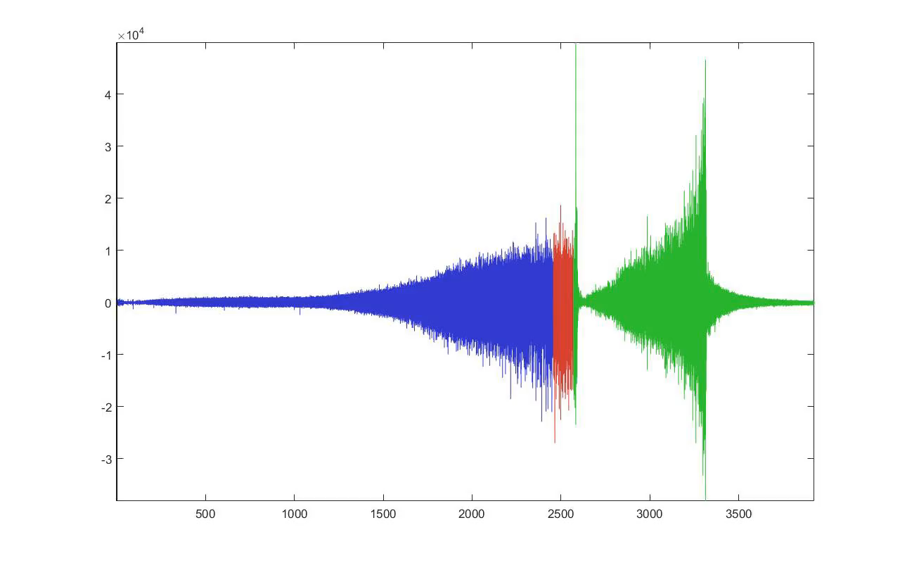
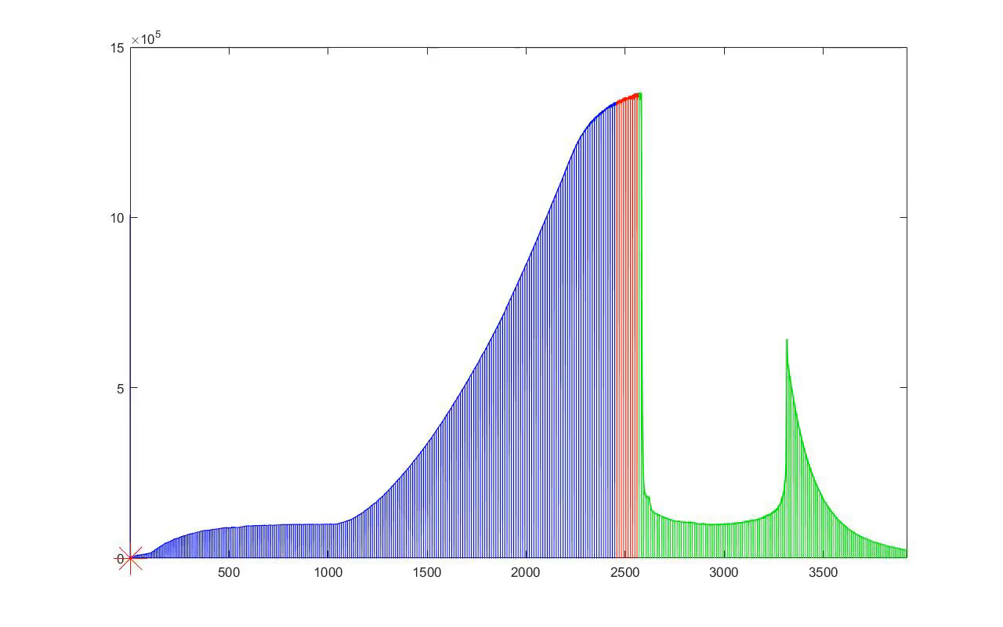
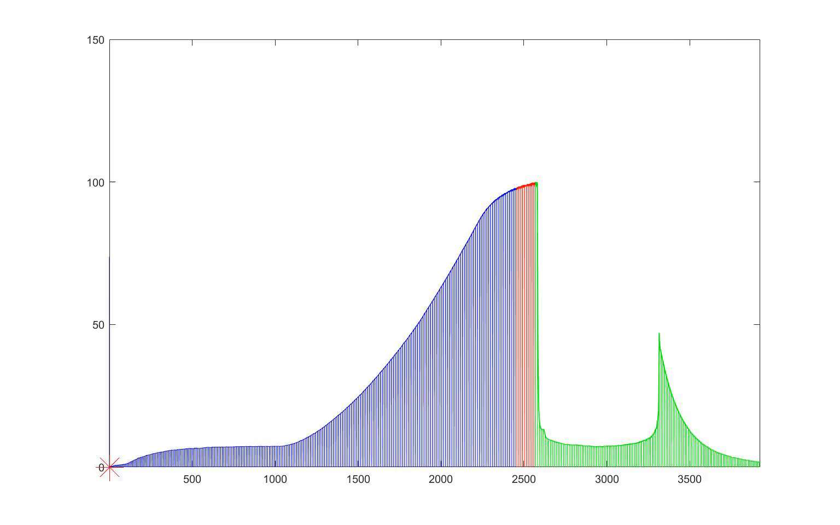
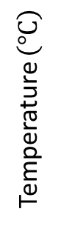
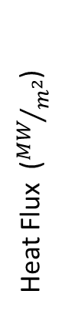
Final Prediction values for data, heat flux and temperature :
A (a.u.)
t(s)
Heat Flux (${MW}/{m^{2}}$)
Temperature $\left(℃\right)$
t(s)
t(s)

Slide 14
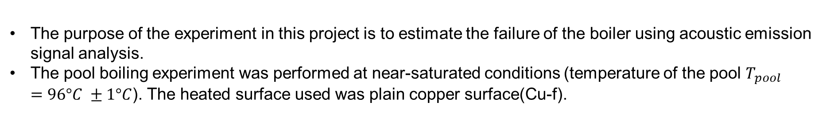
Discussion
The purpose of the experiment in this project is to estimate the failure of the boiler using acoustic emission signal analysis.
The pool boiling experiment was performed at near-saturated conditions (temperature of the pool $T_{pool}=96°C ±1°C$). The heated surface used was plain copper surface(Cu-f).
Conclusion
We used acoustic emissions to detect boiling crisis and prevent thermal runaway in a boiler.
We visualized the change in the distance between data points in 3-D space as they scatter and found that it increases as we approach Critical Heat Flux (CHF).
We plotted the scatter distance as a function of time, and observed an increase just before CHF, which could be a predictor of boiling crisis.
We found that the 4th moment with a threshold value of 5 was the most effective predictor for our primary dataset and four other datasets, with an average effectiveness of 86.07 percent.
We compared the Heat Flux at the threshold with the Heat Flux at CHF to measure the effectiveness of our approach.
We propose that moment can be used as a predictive feature for CHF in various systems and scenarios.
Threshold | DataSet 1 | DataSet 2 | DataSet 3 | Dataset 4 | Dataset 5
5 | 93.946 | 79.5487 | 97.961 | 85.71884 | 73.19111

Slide 15
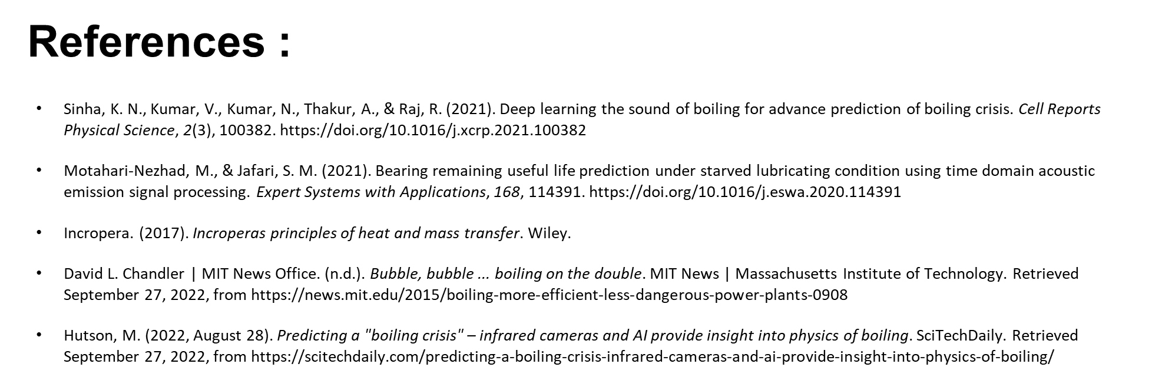

Slide 16
THANK YOU

Slide 17
Backup Slides

Slide 18
Analysis of Moments and Threshold Value for Fluctuation Detection as Precursor to Critical Heat Flux Prediction
Table: Heat Flux Percentage Values of 4th Moment for Different Threshold Values and Datasets
Threshold | DataSet 1 | DataSet 2 | DataSet 3 | Dataset 4 | Dataset 5
0.05 | 44.9084 | 32.1379 | 50.432 | 48.3730556 | 34.46699555
0.1 | 52.1391 | 37.6833 | 58.052 | 49.5887433 | 41.61370271
0.5 | 69.7714 | 57.9089 | 86.339 | 64.5650323 | 56.57124154
1 | 75.7434 | 60.9887 | 97.961 | 70.1220368 | 62.43236311
3 | 87.1154 | 71.7765 | 97.961 | 80.5090443 | 70.15746014
5 | 93.946 | 79.5487 | 97.961 | 85.7188419 | 73.19110642
Dataset 1 : TIME ACOUSTICS HEAT FLUX AND PERCENTAGE CHF DATA FOR SUDDEN STEPPED UP HEATING CASE
Dataset 2: TIME ACOUSTICS HEAT FLUX AND PERCENTAGE CHF DATA FOR NANOSTRUCTURED COPPER SURFACE
Dataset 3 : TIME ACOUSTICS HEAT FLUX AND PERCENTAGE CHF DATA FOR CUF RAMPED UP HEATING CASE
Dataset 4 : TIME ACOUSTICS HEAT FLUX AND PERCENTAGE CHF DATA FOR CUF AND SURFACTANT SOLUTION CASE
Dataset 5 : TIME ACOUSTICS HEAT FLUX AND PERCENTAGE CHF DATA FOR CUF AND IONIC LIQUID SOLUTION CASE

Slide 19
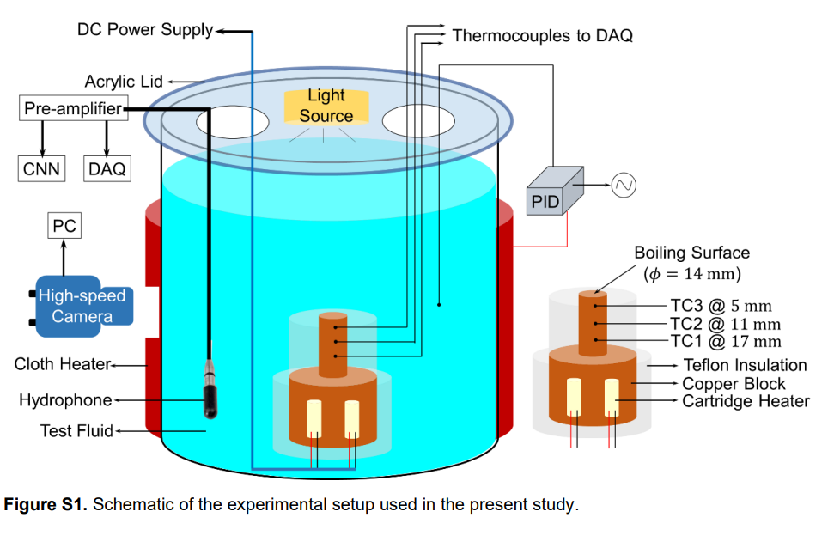
Experimental Setup :
Our audio data was gathered from an experiment conducted by Sinha et al. In his setup there was a heater assembly with a copper block and Teflon insulation. In the experiment two cartridge heaters were used to provide the heat flux at the boiling surface. Measurement of surface temperature and the heat flux was done with the help of three thermocouples. A glass container was used as the boiling chamber which was maintained at near-saturated conditions with a silicone rubber heater and a PID system. The acoustic emissions were recorded during the boiling experiments with a hydrophone and a pre-amplifier. Images of bubbles were also captured with a high-speed camera.

Slide 20
Problem Statement:
The objective of this study is to predict Critical Heat Flux using acoustic emission signals, which are sounds produced by the boiling process, and analysing them using features that capture their patterns and variations over time.
Overview of Our Approach :
Acoustic Emission Signal Processing in Time Domain For Pre-Decided Features
Categorisation
Feature Identification for Determination of Precursor to CHF
Dynamic Plotting of Acoustic Signal Features , Mean and Standard Deviation Against Audio Data Time Series
3D Visualisation Approach with Top, Side, and Front Views

Slide 21
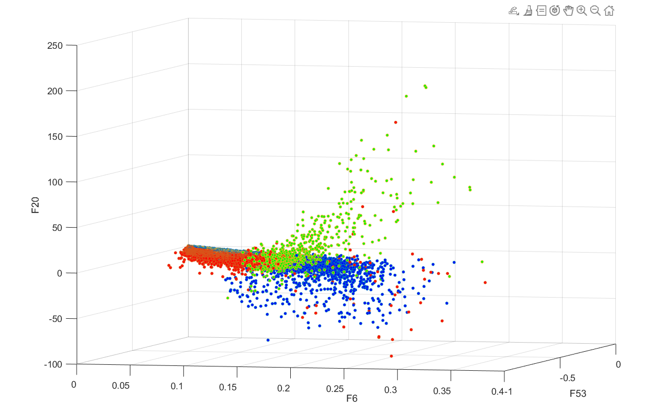
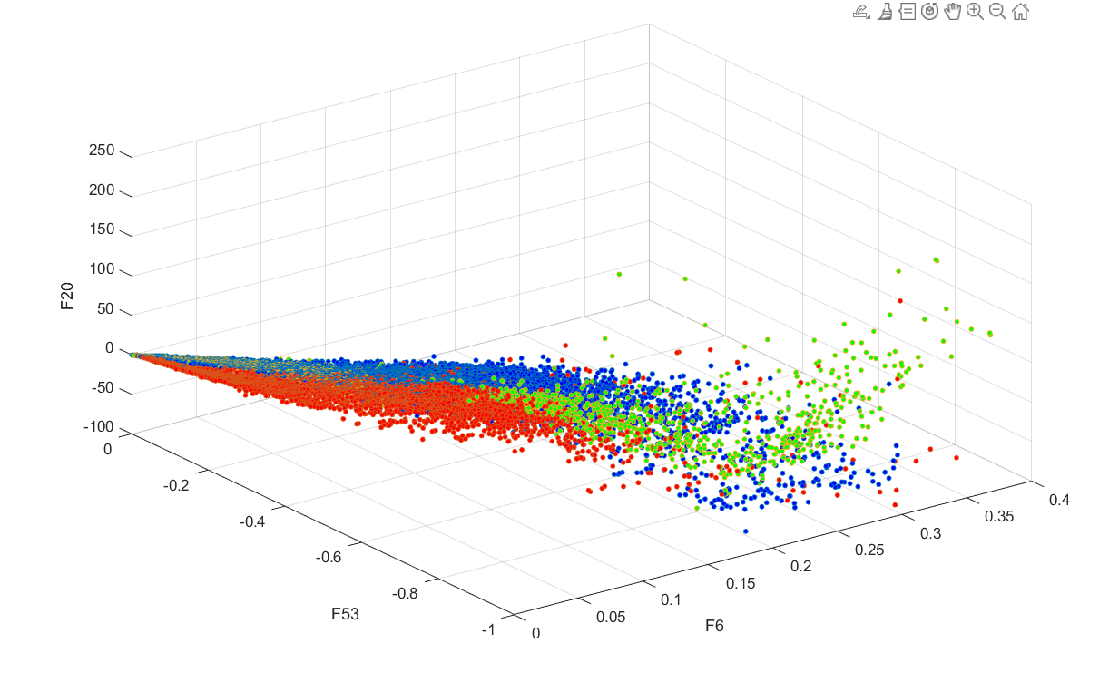
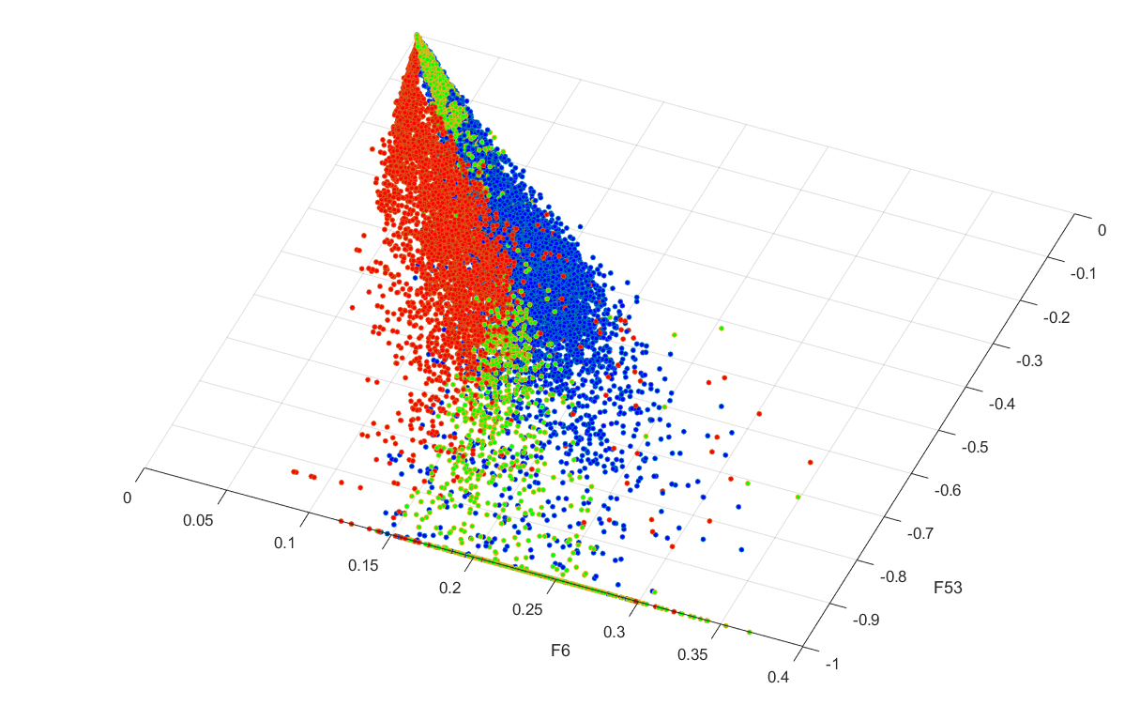
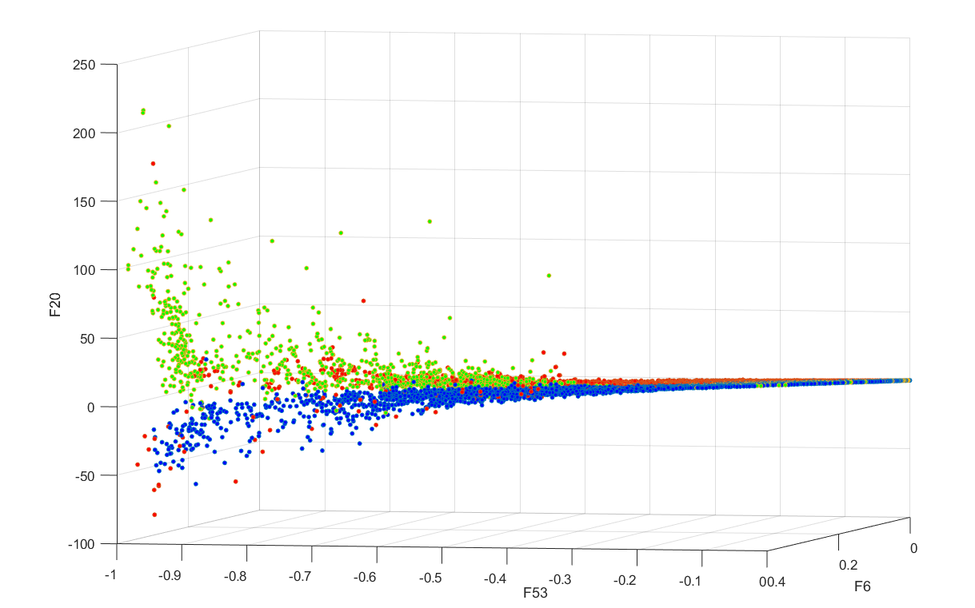

Slide 22
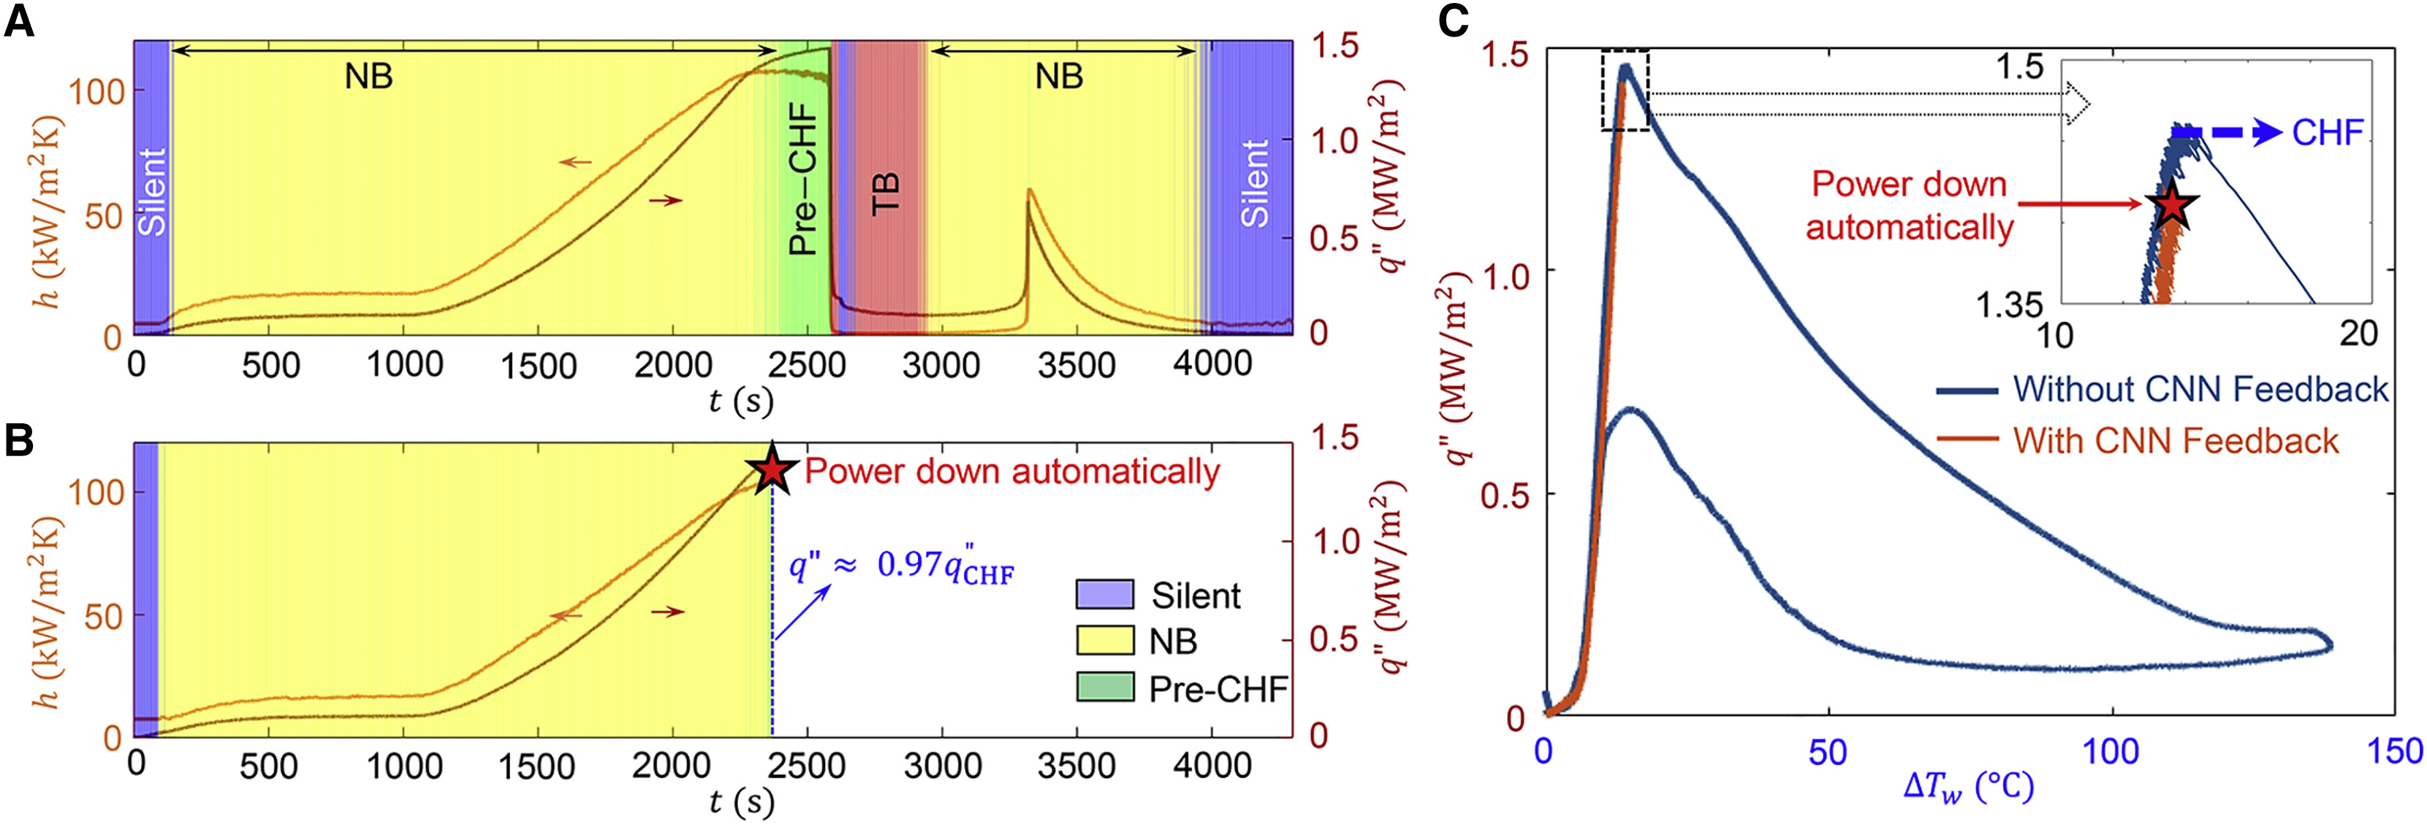

Slide 23
All Figures Demarcations:
0 to 150s : Natural Convection as indicated by the red line
150 to 2581s : Nucleate boiling between red and green line
2582 to 3304s : Transition boiling between green and red line
3305 to 4000s : Fully fledged nucleate boiling between two red lines
4000 to 4500s : Natural convection
Black line represents when the fluctuation starts.

Slide 24
Timeline :
Collect and analyse acoustic emission data
Identify appropriate and inappropriate feature groups
Categorize features based on predictive analysis with respect to CHF
Investigate the effects of changing window-size and window-overlap on predictive ability
Select features and plot their mean and standard deviation
Use live-time plotting to investigate the relationship between features and their mean and standard deviation

